Slide 1
STRATEGIC - TACTICAL PLANNING GUIDE

Slide 2
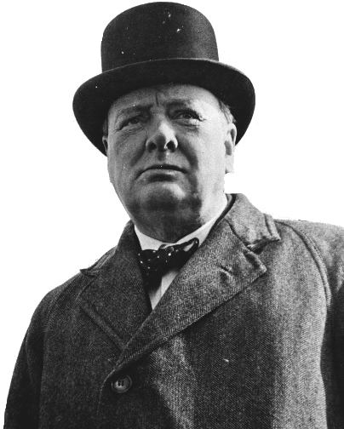
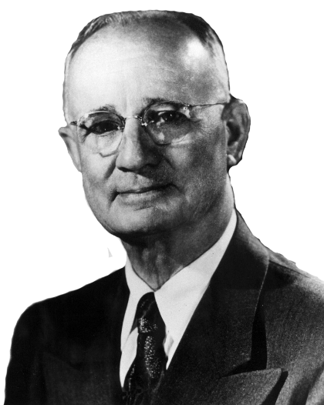
“He who fails to plan, plans to fail.”
– Winston Churchill
“First comes thought; then organization of that thought, into ideas and plans; then transformation of those plans to reality. The beginning, as you will observe, is in your imagination.”
– Napoleon Hill

Slide 3
Critical Indicator Dashboard
TM
PERFORMANCE STATS
Revenue Per Employee
Spread Per Employee
Productivity Margin
Revenue Per Relationship
Client Retention
Employee Engagement
Conversion Rate
Closing Ratio
% Spent on Non - Validated Producers
New business % of Revenue

Slide 4
Future Producer Plans
TM
List all of your current producers and their projected Gross Commission Income per year shown.
Name | Gross Comm. Year 2015 | Gross Comm. Year 2016 | Gross Comm. Year 2017 | Gross Comm. Year 2018 | Gross Comm. Year 2019

Slide 5
Future Support Team Plans
TM
Identify the number of employees you currently have in each category and project for the next 5 years.
Name | Year 2015 | Year 2016 | Year 2017 | Year 2018 | Year 2019
PL Service
CL Service
Benefits Services
Claims
Accounting
Automation
Marketing / Placing
BDC
Senior Mgt.
Middle Mgt.
Other

Slide 6
The Clarity Filter
TM
Client Experience
Brainstorm words that represent what you want clients to feel and receive from your company.
Group these words and thoughts into 5 or fewer Experience words or phrases
Client Experience Icons
What icons could you use to capture these client Experience words or phrases?

Slide 7
The Clarity Filter - Product
TM
What do you sell?
How are these products impacting your company?
What one thing could we package that we already do?
What could you sell?
How would that improve your business?

Slide 8
The Clarity Filter - Brand
TM
What do people think of us today?
How do we communicate our brand today? | What is the best brand opportunity we could take advantage of in the future?
How is our current brand differentiating us? | What do we want people to think of us in the future?
Brand

Slide 9
Vision Reality Creator
Future Vision Goals Date_____________ | Why are these goals important to us? | What must be done this year to make those goals a reality?

Slide 10
One Year Reality Creator
What must happen this year to reach long term vision? | Who Owns? | Tactical Plan Date | How do we know we were successful?

Slide 11
Strategic Project Brainstorm Tool
Item: | Owner:
End in Mind:
Parking Lot IDEAS (WHAT):
Key Themes (WHY):
Action Plan Item: |  | WHO | WHEN

Slide 12
Priority Filter
TM
Item | Describe | Best Outcome | Who Benefits? Business Client Employee | Cost to Implement | Non Financial Benefits | What if we Don’t? | Now No Later | Rank
Licensed from LGL Business Solutions for use.

Slide 13
Strategic Project Calendar
Item | Jan | Feb | Mar | Apr | May | Jun | Jul | Aug | Sep | Oct | Nov | Dec

Slide 14
Notes

Slide 15
Notes

Slide 16
Notes

Slide 17
Notes

Slide 18
Notes

Slide 19
Notes

