Slide 1

Producer Power Start UpTM

Slide 2
Table of Contents
Snap Shot
Vision Starter
Habit Starter
Skills Starter
Your Story
Your Value Proposition
Your Business Plan

Slide 3
Snap Shot

Slide 4
Snap Shot
On a scale of 1 – 10, with 10 being excellent, how would you rate your competencies in the following categories? After rating each category, please provide a reason why you rated yourself that way.
 | 1 | 2 | 3 | 4 | 5 | 6 | 7 | 8 | 9 | 10 | Why?
Current Network
Networking Techniques
Current Business Acumen
Insurance Knowledge
Persuasive Skills
C-suite Selling
Pipeline Management
Dress – Etiquette
Telling Your Story
Question Asking Skills
Quantifying
Personal Brand
Closing Skills

Slide 5
Snap Shot
On a scale of 1 – 10, with 10 being excellent, how would you rate your competencies in the following categories? After rating each category, please provide a reason why you rated yourself that way.
 | 1 | 2 | 3 | 4 | 5 | 6 | 7 | 8 | 9 | 10 | Why?
Entry Strategies
Internal Team Mgmt
Know and Manage your Numbers
Building Networks
Client Retention
Presentation Skills
Alternative Risk Selling
Niche development
Managing a Plan
Selling Intellectual Property
Organizational Skills

Slide 6
Vison Starter

Slide 7
Vision Starter
In this training module, input your 1, 3 and 5 year goals for each category.
Financial
Year 1
Year 3
Year 5
Family
Year 1
Year 3
Year 5
Social
Year 1
Year 3
Year 5

Slide 8
Vision Starter
In this training module, input your 1, 3 and 5 year goals for each category.
Purpose
Year 1
Year 3
Year 5
Company Objectives
Year 1
Year 3
Year 5
Personal Brand
Year 1
Year 3
Year 5

Slide 9
Habit Starter

Slide 10
Personal Development
Three Areas of Critical Development
Business Acumen Action | My Commitment
Technical Skills | My Commitment
Sales Skills – Behavioral Science | My Commitment

Slide 11
Relationship Management
Team
Prospects

Slide 12
Relationship Management
Clients
Influencers

Slide 13
Habit Starter

Slide 14
Habit Starter

Slide 15
Habit Starter

Slide 16
Dress – Etiquette
CORE PHILOSOPHIES
30 Second Rule: “People will make a decision about your brand in the first 30 seconds. Make sure your dress tells them what to think.”
Dress and appearance suggest credibility of position and status.
It’s ok to call ahead and ask about appropriate attire to an event.
It’s not all about you. So, don’t dress to gain undue or unwanted attention.
Dress ½ up to be considered an Advisor.

Slide 17
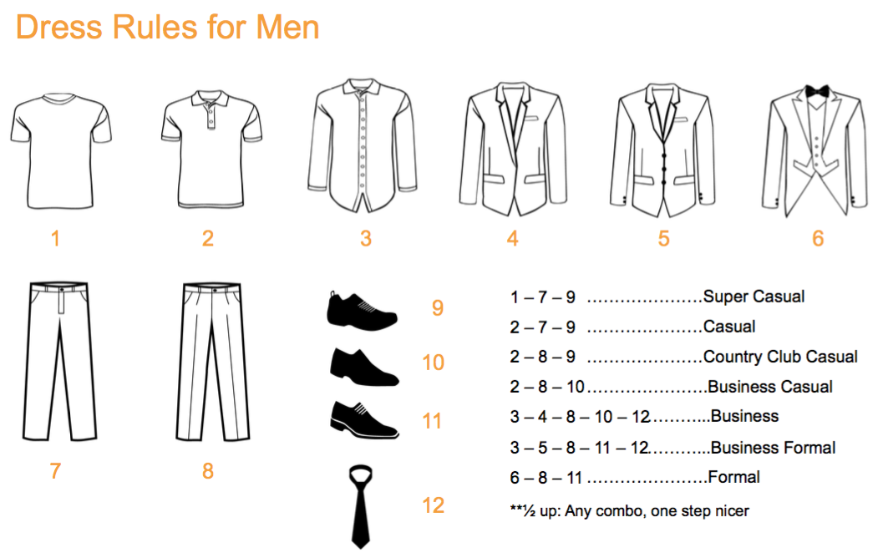
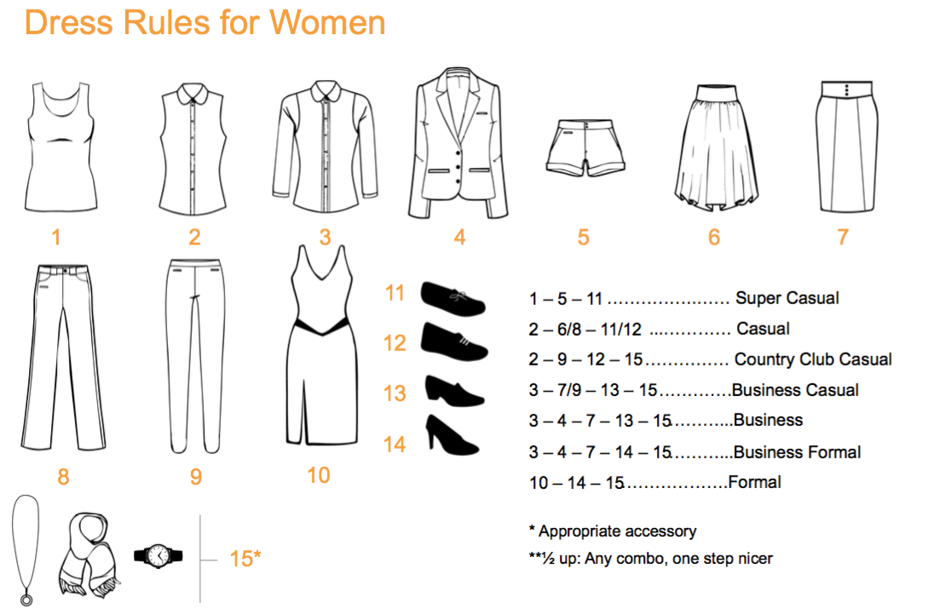
Dress – Etiquette

Slide 18
Dress – Etiquette
Table Manners: Top 10 Mistakes
Pushing your plate away or stacking dishes when you have completed your meal.
Blowing your nose at the table.
Eating a larger than bite-size piece of food.
Chewing with your mouth open.
Talking with food in your mouth.
Eating a dinner roll by breaking it in half rather than tearing a bite-sized piece. No bread and butter sandwiches!
Beginning to eat before everyone at the table has been served.
Acting as though ice cubes are the edible part of a beverage.
Bringing your face to your food, instead of the reverse.
Putting your napkin on your lap when you sit down, rather than waiting until everyone at the table has been seated.
Additional Etiquette Advice
In the purest sense of the word, etiquette means to make others comfortable by being graceful and fitting in appropriately. So, look around you and do things that are more others focused than selfish.
Be on time. Texting that you are running late is not acceptable for being late.
Always RSVP, whether you are going or not. An RSVP is a request for you to respond.
Turn off technology around others. Be in the moment. You will see that those who are off of technology will be the most attractive at an event.
You don’t have to take a picture of everything you do. Allow your memory to capture some of the events in your life.
Do not show up to a party empty handed. Bring wine, a small gift, or a dessert.
Do what you say you will do.
Say please and thank you.

Slide 19
Personal Brand Management
List what people would say about you in single words or short phrases below:
List what you would want people to say about you in single words or short phrases below:

Slide 20
Personal Brand Management
What items on the previous page were the same?
What items would fail the test of “have to have” to be in the game?
What items would pass the test of differentiation?
Add additional differentiation Branding items:

Slide 21

Network Expansion

Slide 22
Skills Starter

Slide 23
Presentation Skills
PRESENTATION SKILLS
P
R
E
S

Slide 24
Persuasion Skills
PERSUASION SKILLS
How can I "know" my client’s business better?
What visuals can I use to connect with the visual senses of my audience?
What are the most compelling reasons why someone should do business with our company?

Slide 25
Persuasion Skills
PERSUASION SKILLS
Describe how to show someone you CARE about them and their business.
Describe the best strategies to engage with people properly at a networking event.
What are some strategies you will use to engage with people at a level where they will want to spend time with you?

Slide 26
Understanding WHY People Buy
Clients
Employees

Slide 27
Understanding WHY People Buy
Profit
Executive Satisfaction

Slide 28
Understanding HOW to Sell Intellectual Property
Insurance Product Sales | Value Add – Solutions | Intellectual Property
What wins? | What wins? | What wins?
How do you lose? | How do you lose? | How do you lose?
How big is competition? | How big is competition? | How big is competition?
How do I sell? | How do I sell? | How do I sell?

Slide 29
Your Story

Slide 30
Your Story
Problem(s)
Response

Slide 31
Your Story
Examples
Next Steps

Slide 32
Your Value Proposition

Slide 33
Your Value Proposition
Describe the agency process that brings value to the clients of your agency
How can you bring value to this process?

Slide 34
Why Our Process Sells!
The Process brings value because...
What value does the assessment bring to a prospect/client?
How do "plans" impact a client and what is different about a plan vs a "presentation"

Slide 35
An Effective Assessment
Question Asking
Quantifying
Process

Slide 36
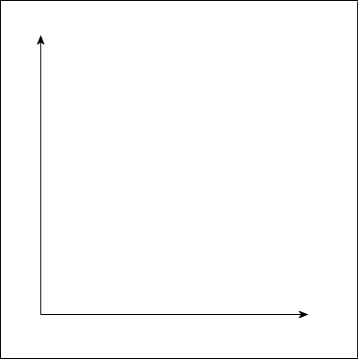
An Effective Assessment
Band of Pricing
CO ST
TIME

Slide 37
An Effective Plan
A plan is...
Problem:
Quantify:
Solution:
Calendar:
Get Agreement:

Slide 38
Your Business Plan

Slide 39
Network Expansion Plan
Where to build networks
Who are the best centers of influence
Building a network around YOU

Slide 40
Prospect Engagement Plan
Targeted Prospects
Target Account Strategy Plan
Researching Prospects

Slide 41
Prospect Engagement Plan
Account Name:
Strategic Decision Makers:
Name:
Title:
Influence:
Incumbent Agent:
Incumbent Agency / Brokerage:
Typical strategy / strength / weakness of incumbent:

Slide 42
Prospect Engagement Plan
Our strengths in this industry class:
What products / services do we have that bring value to this industry?
What InCite Wiki Risks should be studied in preparation for the prospect?
Who can we connect to this prospect (relationships, LinkedIn, social)?
What top emerging industry risks should we be prepared to discuss?

Slide 43
Prospect Engagement Plan
What, if any, past history do we have with this prospect?
What type of people does this company hire? (Look at hiring profiles)
Check off key items to be done in preparation:
Web Site Review
LinkedIn search on people
LinkedIn search on company
Contact Referral(s)
Industry Emerging Risks
Work Comp information online
5500 Search (Freearisa.com)
Total social media search on key decision makers
Strategy to get business:
Who:
What:
When:

Slide 44
Know Your Numbers
Goal | Goal x 1.25% | Conversion % | Closing % | Average Account Size (commission) | Number of First Calls | Number of Proposals | New Clients
$75,000.00 | $93,750.00 | 0.75 | 0.8 | $2,500.00 | 62.5 | 50.0 | 37.5
$120,000.00 | $150,000.00 | 0.75 | 0.8 | $10,000.00 | 25.0 | 20.0 | 15.0
$50,000.00 | $62,500.00 | 0.6 | 0.7 | $10,000.00 | 14.9 | 10.4 | 6.3
$100,000.00 | $125,000.00 | 0.75 | 0.9 | $10,000.00 | 18.5 | 16.7 | 12.5
$100,000.00 | $125,000.00 | 0.25 | 0.25 | $5,000.00 | 400.0 | 100.0 | 25.0

Slide 47
Habits for Success
”Show me your goals and I will give you a high five and wish you the best. Show me your habits and I will tell you what you will accomplish.” Larry G. Linne
Habits of Highly Successful Producers
Wake up early
Start early and at the same time
Read
Refine
Set goals based on history and potential and not on company standards
Set scheduled and regular prospecting times
Disciplined to prospecting times
Practice skills
Do not fear being uncomfortable and seek those opportunities
Study behavior science and not just selling techniques
Practice Critical Thinking vs Soundbite Acceptance
Never satisfied
Celebrate Success

