Slide 1

Account Manager
Development Program

Slide 2
Welcome
Watch: Account Manager Development Program – Introduction Video
What to Expect from this Program
Your 90 Day Plan
The Normal Learning Cycle – Avoid the death zone
Unconscious
Incompetence
Conscious
Incompetence
Conscious
Competence
Unconscious
Competence

Slide 3
Account Manager Development Strategies
The following strategies are designed as a progressive method of development to maximize productivity and success.
Team Dynamics
Growth
Selling Intellectual Property
Client Experience
Performance Management
Personal Development Plans
Improve Productivity
Personal Brand

Slide 4
Account Manager Development Strategies
Topic Summaries
Team Dynamics
Teams thrive and fail based upon how they communicate, leverage each other’s talents and work together. Your ability to create the right team dynamics is essential to your long term success and that of your agency/brokerage.
Growth
Growth is essential. Any organization that isn’t growing is going backward. The ability to obtain new clients and retain the clients you already have is a must. But, growth is also a mindset of HOW to engage the behaviors that are in alignment with growth.’
Selling intellectual Property
Your understanding of this sales philosophy will help when delivering the highest level of client experience Selling Intellectual Property is a sales philosophy in which the agency/brokerage is seen as a trusted advisor and educator that challenges the status quo. The ultimate goal is to help the client have more control and greater options when managing risk and insurance.
Client Experience
Client experience is the interaction with clients over the length of the relationship. A great client experience leads to long term relationships. It focuses on touchpoints as well as the environment the customer experiences when interacting with the organization. This impacts our brand and reputation in the marketplace.
Performance Management
Performance matters. Performance management isn’t about micro-management. It is about self management and great coaching to assist the individual in becoming highly successful in their role.
Personal Development Plans
We live in a highly competitive and changing world. To remain relevant and valuable in today’s environment, each individual must focus on personal development. When personal development wanes, value wanes.
Improve Productivity
Highly productive teams have more success and more fun. Highly productive organizations are more profitable and able to offer more opportunity to their employees. Productivity is a key to an organizations ability to remain competitive in the marketplace.
Personal Brand
Brand is what people think and say about an individual. A positive brand creates advocates. A negative brand creates barriers to success.

Slide 5
Account Manager Development Strategies
Development Strategy 1 – Team Dynamics
Watch: Account Manager Development Program – Team Dynamics
Relationships
FIC/2IC
Meetings/Communication
Natural Talents (Kolbe)
Tools:
Kolbe™
https://incitepg.com/understanding-the-basics-of-kolbe/
Consequence Worksheet™
https://incitepg.com/resources2/?ofsearch=consequence+worksheet
“Make the Noise Go Away” by Larry G. Linne
NOTES:
____________________________________________________________
____________________________________________________________
____________________________________________________________
____________________________________________________________
____________________________________________________________
____________________________________________________________
____________________________________________________________
™

Slide 6
Team Dynamics
What successes have you had in implementing Team Dynamics?
What challenges have you had in implementing Team Dynamics?
What will you implement from this session?
What questions or comments do you have for your supervisor?

Slide 7
Account Manager Development Strategies
Development Strategy 2 – Growth
Watch: Account Manager Development Program - Growth
Client Retention Strategies
Account Development (Inside & Outside LOB)
Referrals
Know your BOB – Revenue, Retention, Net Growth
Tools:
Client Retention Assessment™
https://incitepg.com/resources2/?ofsearch=client+retention+assessment
https://incitepg.com/retention-increasing-the-probability-of-retaining-clients/
NOTES:
____________________________________________________________
____________________________________________________________
____________________________________________________________
____________________________________________________________
____________________________________________________________
____________________________________________________________
____________________________________________________________

Slide 8
Growth
What are you doing well today that impacts growth for the agency?
What could you implement moving forward to become more growth focused?
What steps will you take to promote growth within the agency?
What questions or comments do you have for your supervisor?

Slide 9
Account Manager Development Strategies
Development Strategy 3 – Selling Intellectual Property
Watch: Account Manager Development Program - Selling Intellectual Property
Education
Challenge
Collaboration
Risk is driver
Tools:
Risk Opportunity™
Band of Pricing™
Integrated Solutions™ Assessment and Plan
NOTES:
____________________________________________________________
____________________________________________________________
____________________________________________________________
____________________________________________________________
____________________________________________________________
____________________________________________________________
____________________________________________________________

Slide 10
Understanding How To Sell
Intellectual Property
Insurance Product Sales | Value Add – Solutions | Intellectual Property
What wins? | What wins? | What wins?
How do you lose? | How do you lose? | How do you lose?
How big is competition? | How big is competition? | How big is competition?
How do I sell? | How do I sell? | How do I sell?

Slide 11
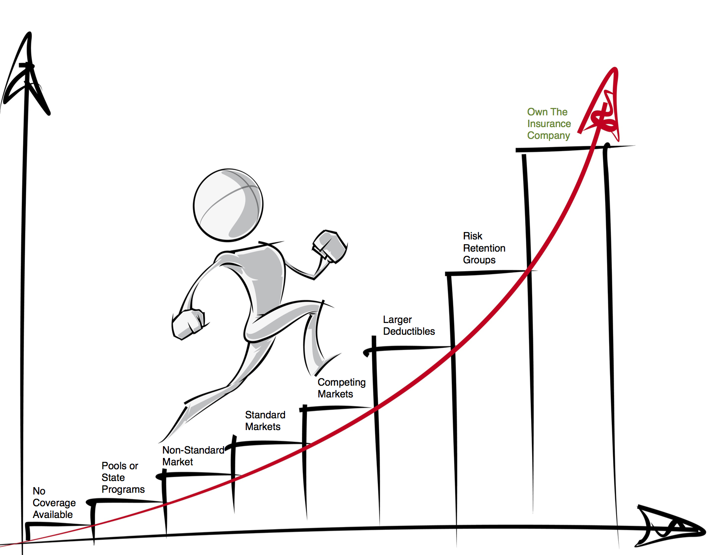
Understanding How To Sell
Intellectual Property

Slide 12
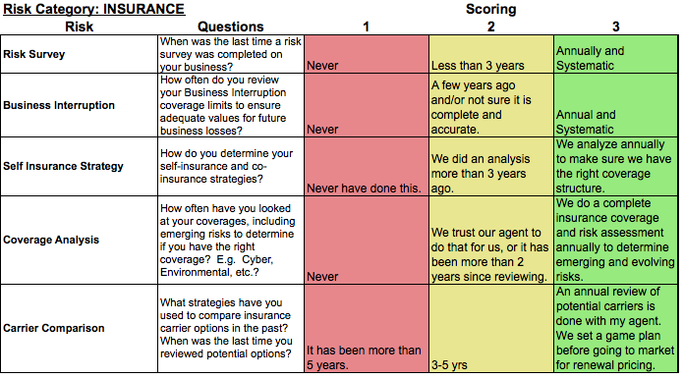
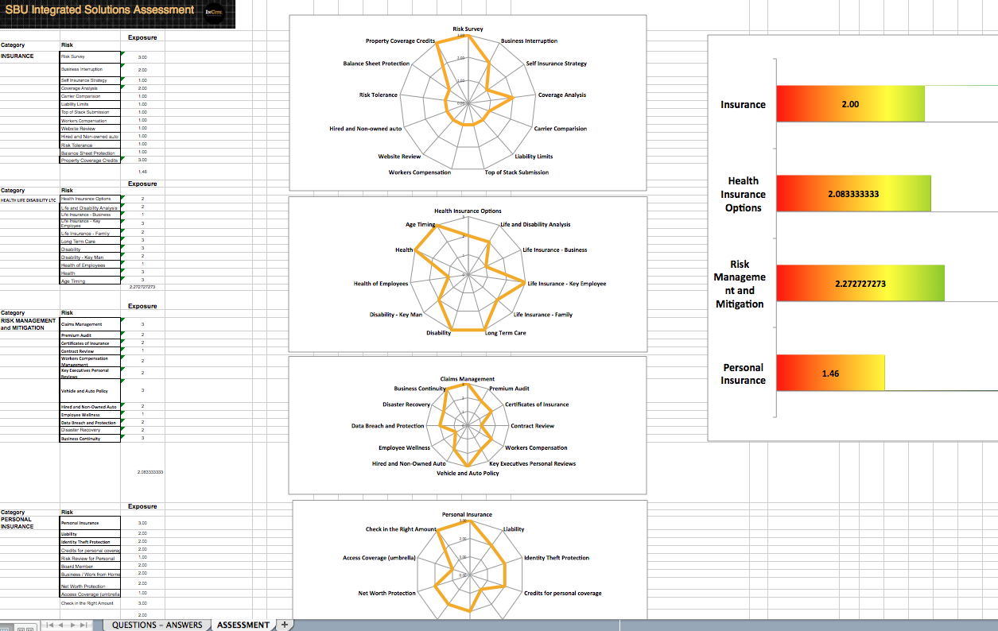
Integrated Solutions Assessment

Slide 13
Integrated Solutions Plan

Slide 14
Integrated Solutions Plan

Slide 15
Selling Intellectual Property
What value do your clients receive from this sales philosophy?
What is your role in the sales process? How can you more effectively execute that role?
What questions or comments do you have for your supervisor?

Slide 16
Account Manager Development Strategies
Development Strategy 4 – Client Experience
Watch: Account Manager Development Program - Client Experience
All Interactions with Standards
Strategic Client Management
Emotional Intelligence
Tools:
Brand Compass
https://incitepg.com/resources2/?ofsearch=Brand+Compass
Agency Manifesto
https://incitepg.com/resources2/?ofsearch=agency+growth+manifesto
NOTES:
____________________________________________________________
____________________________________________________________
____________________________________________________________
____________________________________________________________
____________________________________________________________
____________________________________________________________
____________________________________________________________

Slide 17
Client Experience
What is working with your client experience today?
What areas of your client experience need improvement?
What can you do to help improve the client experience?
What questions or comments do you have for your supervisor?

Slide 18
Account Manager Development Strategies
Development Strategy 5 – Performance Management
Watch: Account Manager Development Program – Performance Management
Performance Objectives
Self-Reporting – RPM
Upward Communication
Tools:
Account Manager Performance Objectives
NOTES:
____________________________________________________________
____________________________________________________________
____________________________________________________________
____________________________________________________________
____________________________________________________________
____________________________________________________________
____________________________________________________________

Slide 19
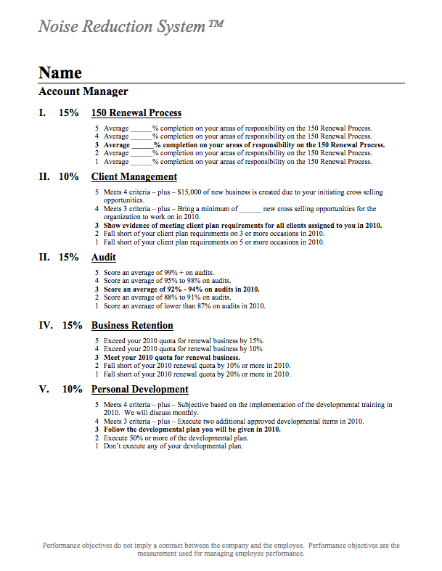
Performance Objectives

Slide 20
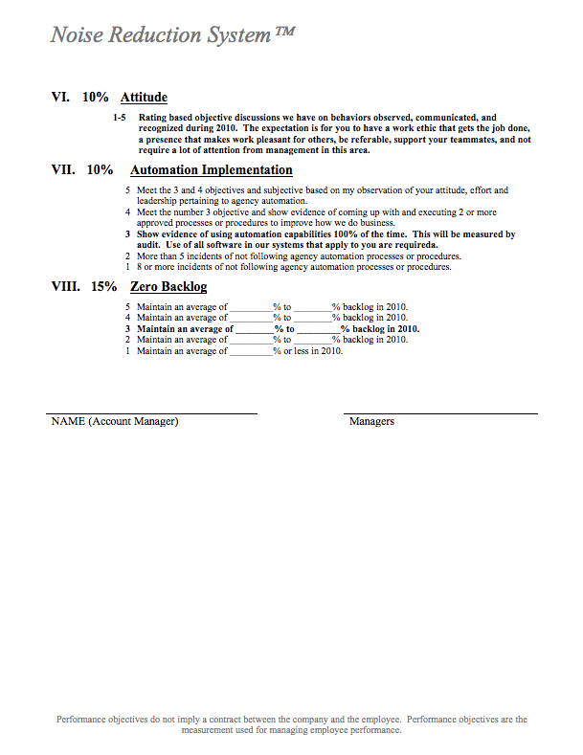
Performance Objectives

Slide 21
Performance Management
What elements of performance management are clear to you?
Where do you need greater clarity around your performance?
What questions or comments do you have for your supervisor?

Slide 22
Account Manager Development Strategies
Development Strategy 6 – Personal Development Plans
Watch: Account Manager Development Program - Personal Development Plans
Assessment
Culture Inventory
Development Plan
Tools:
Operations Onboarding Accelerator
https://incitepg.com/resources2/?tag=534
NOTES:
____________________________________________________________
____________________________________________________________
____________________________________________________________
____________________________________________________________
____________________________________________________________
____________________________________________________________
____________________________________________________________

Slide 23
Personal Development Plans
Technical Knowledge (Personal)
Item | No Knowledge | Basic Knowledge | Intermediate Knowledge | Mastery Knowledge | Training Required (Y/N) | Notes
Property | ☐ | ☐ | ☐ | ☐
Automobile | ☐ | ☐ | ☐ | ☐
Umbrella | ☐ | ☐ | ☐ | ☐
Automobile Endorsements | ☐ | ☐ | ☐ | ☐
Personal Effects | ☐ | ☐ | ☐ | ☐
Collectibles | ☐ | ☐ | ☐ | ☐
Recreational Vehicles | ☐ | ☐ | ☐ | ☐
Trailers | ☐ | ☐ | ☐ | ☐
Antique Vehicles | ☐ | ☐ | ☐ | ☐
Builder’s Risk | ☐ | ☐ | ☐ | ☐
Personal Farms | ☐ | ☐ | ☐ | ☐
Marine | ☐ | ☐ | ☐ | ☐
Aviation | ☐ | ☐ | ☐ | ☐
Cyber Liability | ☐ | ☐ | ☐ | ☐
Licensing | ☐ | ☐ | ☐ | ☐
Accreditations | ☐ | ☐ | ☐ | ☐

Slide 24
Personal Development Plans
Technical Knowledge (Commercial)
Item | No Knowledge | Basic Knowledge | Intermediate Knowledge | Mastery Knowledge | Training Required (Y/N) | Notes
Property | ☐ | ☐ | ☐ | ☐
Commercial Fleet | ☐ | ☐ | ☐ | ☐
Standard Garage | ☐ | ☐ | ☐ | ☐
Directors & Officers | ☐ | ☐ | ☐ | ☐
Errors & Omissions | ☐ | ☐ | ☐ | ☐
Commercial General Liability | ☐ | ☐ | ☐ | ☐
Commercial Umbrella | ☐ | ☐ | ☐ | ☐
Bonding | ☐ | ☐ | ☐ | ☐
Certificates | ☐ | ☐ | ☐ | ☐
Builder’s Risk | ☐ | ☐ | ☐ | ☐
Equipment Breakdown | ☐ | ☐ | ☐ | ☐
Aviation | ☐ | ☐ | ☐ | ☐
Marine | ☐ | ☐ | ☐ | ☐
Legal Expense Liability | ☐ | ☐ | ☐ | ☐
Cyber Liability | ☐ | ☐ | ☐ | ☐
Licensing | ☐ | ☐ | ☐ | ☐
Accreditations | ☐ | ☐ | ☐ | ☐

Slide 25
Personal Development Plans
Technical Knowledge (Benefits)
Item | No Knowledge | Basic Knowledge | Intermediate Knowledge | Mastery Knowledge | Training Required (Y/N) | Notes
Carrier programs | ☐ | ☐ | ☐ | ☐
HMO/PPO/POS | ☐ | ☐ | ☐ | ☐
HR & Benefits Compliance | ☐ | ☐ | ☐ | ☐
ACA Compliance for US | ☐ | ☐ | ☐ | ☐
HSA/HRA/FSA | ☐ | ☐ | ☐ | ☐
Self Funded Plans | ☐ | ☐ | ☐ | ☐
Actuarial Skills | ☐ | ☐ | ☐ | ☐
Plan Modeling | ☐ | ☐ | ☐ | ☐
Captive Insurance | ☐ | ☐ | ☐ | ☐
Claims Navigation | ☐ | ☐ | ☐ | ☐
Claims Resolution | ☐ | ☐ | ☐ | ☐
Doctor networks | ☐ | ☐ | ☐ | ☐
Contribution Structures | ☐ | ☐ | ☐ | ☐
Administration (adds/deletes) | ☐ | ☐ | ☐ | ☐
Enrollment/Ben Admin Technology | ☐ | ☐ | ☐ | ☐
Licensing | ☐ | ☐ | ☐ | ☐
Accreditations | ☐ | ☐ | ☐ | ☐

Slide 26
Personal Development Plan Plans
Service Skills Knowledge
Item | No Knowledge | Basic Knowledge | Intermediate Knowledge | Mastery Knowledge | Training Required (Y/N) | Notes
Client Experience | ☐ | ☐ | ☐ | ☐
Cross Selling within line of business | ☐ | ☐ | ☐ | ☐
Cross Selling outside line of business | ☐ | ☐ | ☐ | ☐
Exit Barrier Strategies | ☐ | ☐ | ☐ | ☐
Enhanced Coverage Conversations | ☐ | ☐ | ☐ | ☐
Asking for Referrals | ☐ | ☐ | ☐ | ☐
Presentation Skills | ☐ | ☐ | ☐ | ☐
Proactive vs. Reactive | ☐ | ☐ | ☐ | ☐
Communication Skills | ☐ | ☐ | ☐ | ☐
Problem Solving | ☐ | ☐ | ☐ | ☐
Difficult Client Conversations | ☐ | ☐ | ☐ | ☐
Time Maximization Techniques | ☐ | ☐ | ☐ | ☐
Professionalism | ☐ | ☐ | ☐ | ☐
Personal Brand | ☐ | ☐ | ☐ | ☐

Slide 27
Personal Development Plans
Technology/Systems Knowledge
Item | No Knowledge | Basic Knowledge | Intermediate Knowledge | Mastery Knowledge | Training Required (Y/N) | Notes
Agency Management System | ☐ | ☐ | ☐ | ☐
Building Evaluator System | ☐ | ☐ | ☐ | ☐
Microsoft Word | ☐ | ☐ | ☐ | ☐
Microsoft Excel | ☐ | ☐ | ☐ | ☐
Microsoft Power Point | ☐ | ☐ | ☐ | ☐
Outlook | ☐ | ☐ | ☐ | ☐
Prospecting System (e.g. PipeDrive) | ☐ | ☐ | ☐ | ☐
Desktop Faxing System (e.g. fax advantage) | ☐ | ☐ | ☐ | ☐
Insurance Company Websites | ☐ | ☐ | ☐ | ☐
Insurance Company Portals | ☐ | ☐ | ☐ | ☐
Online Management (e.g. CSR 24) | ☐ | ☐ | ☐ | ☐
Skype | ☐ | ☐ | ☐ | ☐
Yammer | ☐ | ☐ | ☐ | ☐
InCite Website | ☐ | ☐ | ☐ | ☐
Facebook | ☐ | ☐ | ☐ | ☐
Linkedin | ☐ | ☐ | ☐ | ☐
Twitters | ☐ | ☐ | ☐ | ☐

Slide 28
Personal Development Plans
Business Acumen
Item | No Knowledge | Basic Knowledge | Intermediate Knowledge | Mastery Knowledge | Training Required (Y/N) | Notes
Emerging Risks | ☐ | ☐ | ☐ | ☐
Balance Sheet | ☐ | ☐ | ☐ | ☐
Regional Economics | ☐ | ☐ | ☐ | ☐
National Economics | ☐ | ☐ | ☐ | ☐
World Economics | ☐ | ☐ | ☐ | ☐
WikiRisk | ☐ | ☐ | ☐ | ☐
Daily Relevant Periodicals | ☐ | ☐ | ☐ | ☐
Business finance | ☐ | ☐ | ☐ | ☐
Estate planning details (trusts, will, tax) | ☐ | ☐ | ☐ | ☐
Tax | ☐ | ☐ | ☐ | ☐

Slide 29
Personal Development Plan
Business Acumen Action | My Commitment
Service Skills Action | My Commitment
Technical Skills Action | My Commitment
Technology/Systems Knowledge Action | My Commitment

Slide 30
Personal Development Plan
What are the top 3 areas in which you want to improve?
What is your plan to improve? Books to read? Classes to take? Mentors to leverage?
What questions or comments do you have for your supervisor?

Slide 31
Account Manager Development Strategies
Development Strategy 7 – Improve Productivity
Watch: Account Manager Development Program – Improve Productivity
Time Maximization
Organizational Skills
Self-Awareness
Lean Strategies
Tools:
Lean Waste List -https://incitepg.com/resources2/?ofsearch=lean+waste+list
NOTES:
____________________________________________________________
____________________________________________________________
____________________________________________________________
____________________________________________________________
____________________________________________________________
____________________________________________________________
____________________________________________________________

Slide 32
Improve Productivity
What are your best productivity habits and how can you leverage them even more?
What are the 3 steps you will take to improve your productivity?
What questions or comments do you have for your supervisor?

Slide 33
Account Manager Development Strategies
Development Strategy 8 – Personal Brand
Watch: Account Manager Development Program – Personal Brand
Matters inside and outside the organization
Decide on your Brand
Differentiate Yourself
Blend with the Corporate Brand
Tools:
Personal Branding Guide™
“Brand Aid – Taking Control of your Reputation Before Everyone Else Does” by Larry G. Linne & Patrick Sitkins
NOTES:
____________________________________________________________
____________________________________________________________
____________________________________________________________
____________________________________________________________
____________________________________________________________
____________________________________________________________
____________________________________________________________

Slide 34
Personal Brand Management
List what people would say about you in single words or short phrases below:
List what you would want people to say about you in single words or short phrases below:

Slide 35
Personal Brand Management
What items on the previous page were the same?
What items would fail the test of “have to have” to be in the game?
What items would pass the test of differentiation?
Add additional differentiation Branding items:

Slide 36
Personal Brand
Take a moment to write out your personal brand statement.
What must you do to make this brand a reality?
What questions or comments do you have for your supervisor?

Slide 37
Quarterly Plan
Quarter 1 Plan
Additional Thoughts:
Area of Improvement | Strategy to Improve | By When | Mentor

Slide 38
Quarterly Plan
Quarter 2 Plan
What Improvements did you make in quarter 1?
How have they helped you?
Additional Thoughts:
Area of Improvement | Strategy to Improve | By When | Mentor

Slide 39
Quarterly Plan
Quarter 3 Plan
What Improvements did you make in quarter 2?
How have they helped you?
Additional Thoughts:
Area of Improvement | Strategy to Improve | By When | Mentor

Slide 40
Quarterly Plan
Quarter 4 Plan
What Improvements did you make in quarter 3?
How have they helped you?
Additional Thoughts:
Area of Improvement | Strategy to Improve | By When | Mentor

